Slide 1
Hash Tables
0
U
(universe of keys)
h(k₁)
h(k₄)
K
(actual
keys)
k₁
k₄
k₂
collision
h(k₂)=h(k₅)
k₅
k₃
h(k₃)
m–1

Slide 2
Why Hash table is important?
Linked List/ Array: O(n) times for searching an element in the list
Hash table: expected time for searching an element is O(1)

Slide 3
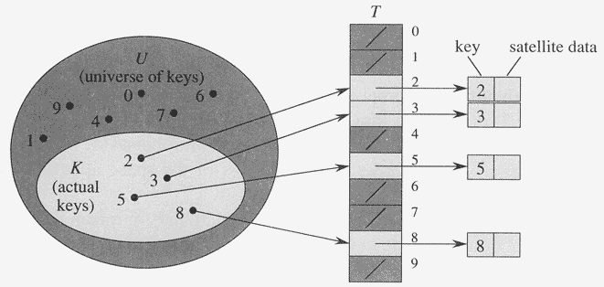
Direct-Address Tables
Direct-address Tables are ordinary arrays
Facilitate direct addressing
  Element whose key is k is obtained by indexing into the k^{th} position of the array
Applicable when we can afford to allocate an array with one position for every possible key
  i.e. when the universe of keys U is small
Dictionary operations can be implemented to take O(1) time

Slide 4
Direct-Address Tables
Suppose:
  The range of keys is 0..m-1
  Keys are distinct
The idea:
  Set up an array T[0..m-1] in which
    T[i] = x if x∈ T and key[x] = i
    T[i] = NULL otherwise
  This is called a direct-address table
    Operations take O(1) time !
    So what’s the problem?

Slide 5
Direct-Address Tables
Direct addressing works well when the range m of keys is relatively small
But what if the keys are 32-bit integers?
  Problem 1: direct-address table will have
  2³² entries, more than 4 billion
  Problem 2: even if memory is not an issue, the time to initialize the elements to NULL may take a lot of time
Solution: map keys to smaller range 0..m-1
This mapping is called a hash function

Slide 6
Hash Tables
Motivation: symbol tables
  A compiler uses a symbol table to relate symbols to associated data
    Symbols: variable names, procedure names, etc.
    Associated data: memory location, call graph, etc.
  For a symbol table (also called a dictionary), we care about search, insertion, and deletion
  We want these to be fast, but don’t care about sorted order
The structure we will use is a hash table
  Supports all the above in O(1) expected time !

Slide 7
Hash Tables
Notation:
  U : Universe of all possible keys.
  K : Set of keys actually stored in the dictionary.
  |K| = n.
When U is very large,
  Arrays are not practical.
  |K| << |U|.
Use a table of size proportional to |K| – The hash tables.
  However, we lose the direct-addressing ability.
  Define functions that map keys to slots of the hash table.

Slide 8
Hashing
Hash function h: Mapping from U to the slots of a hash table T[0..m–1].
  h : U → {0,1,…, m–1}
With arrays, key k maps to slot A[k].
With hash tables, key k maps or “hashes” to slot T[h[k]].
h[k] is the hash value of key k.

Slide 9
Hashing
0
U
(universe of keys)
h(k₁)
h(k₄)
K
(actual
keys)
k₁
k₄
k₂
collision
h(k₂)=h(k₅)
k₅
k₃
h(k₃)
m–1

Slide 10
Issues with Hashing
Multiple keys can hash to the same slot – collisions are possible.
  Design hash functions such that collisions are minimized.
  But avoiding collisions is impossible.
    Design collision-resolution techniques.
Search will cost Ө(n) time in the worst case.
  However, all operations can be made to have an expected complexity of Ө(1).

Slide 11
Methods of Resolution
Chaining:
  Store all elements that hash to the same slot in a linked list.
  Store a pointer to the head of the linked list in the hash table slot.
Open Addressing:
  All elements are stored in hash table itself.
  When collisions occur, use a systematic (consistent) procedure to store elements in free slots of the table.
0
k₁
k₄
k₅
k₂
k₆
k₇
k₃
k₈
m–1

Slide 12
Collision Resolution by Chaining
0
U
(universe of keys)
h(k₁)=h(k₄)
X
k₁
k₄
K
(actual
keys)
k₂
k₆
X
h(k₂)=h(k₅)=h(k₆)
k₅
k₈
k₇
k₃
X
h(k₃)=h(k₇)
h(k₈)
m–1

Slide 13
Collision Resolution by Chaining
Chaining puts elements that hash to the same slot in a linked list:
0
U
(universe of keys)
k₁
k₄
k₁
k₄
K
(actual
keys)
k₂
k₆
k₅
k₂
k₆
k₅
k₈
k₇
k₃
k₇
k₃
k₈
m–1

Slide 14
Chaining
T
U
(universe of keys)
——
k₁
k₄
——
——
k₁
——
K
(actual
keys)
k₄
k₅
——
k₇
k₅
k₂
k₇
——
——
k₂
k₃
k₃
——
k₈
k₆
k₈
k₆
——
——
How do we insert an element?

Slide 15
Chaining
T
U
(universe of keys)
——
k₁
k₄
——
——
k₁
——
K
(actual
keys)
k₄
k₅
——
k₇
k₅
k₂
k₇
——
——
k₂
k₃
k₃
——
k₈
k₆
k₈
k₆
——
——
How do we delete an element?

Slide 16
Chaining
T
U
(universe of keys)
——
k₁
k₄
——
——
k₁
——
K
(actual
keys)
k₄
k₅
——
k₇
k₅
k₂
k₇
——
——
k₂
k₃
k₃
——
k₈
k₆
k₈
k₆
——
——
How do we search for a element with a
given key?

Slide 17
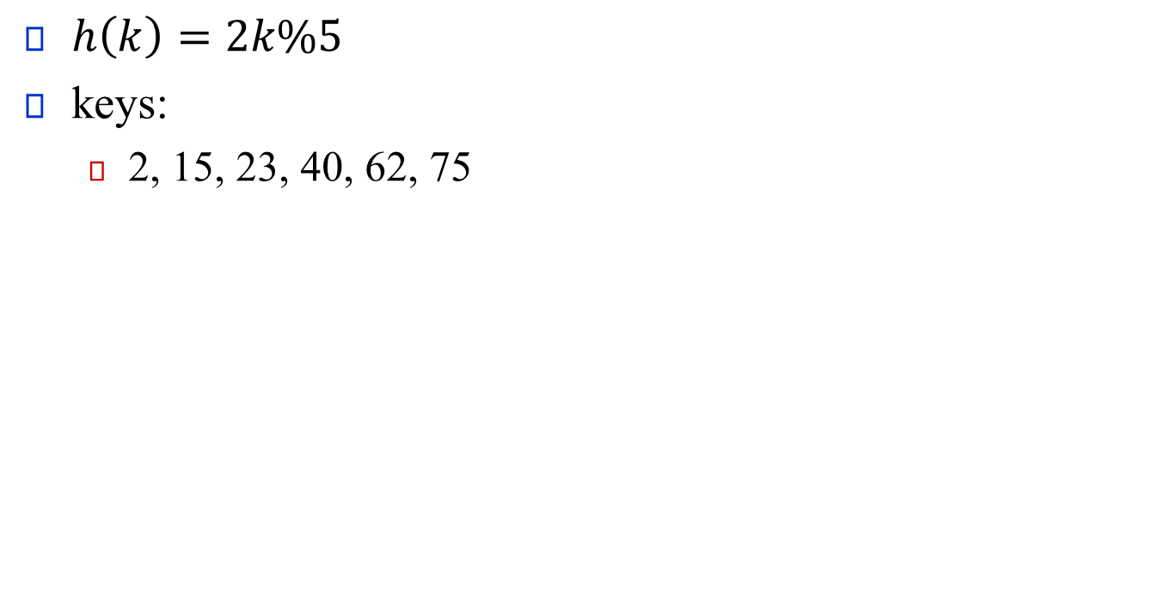
Chaining Example
$h\left(k\right)=2k\%5$
keys:
  2, 15, 23, 40, 62, 75

Slide 18
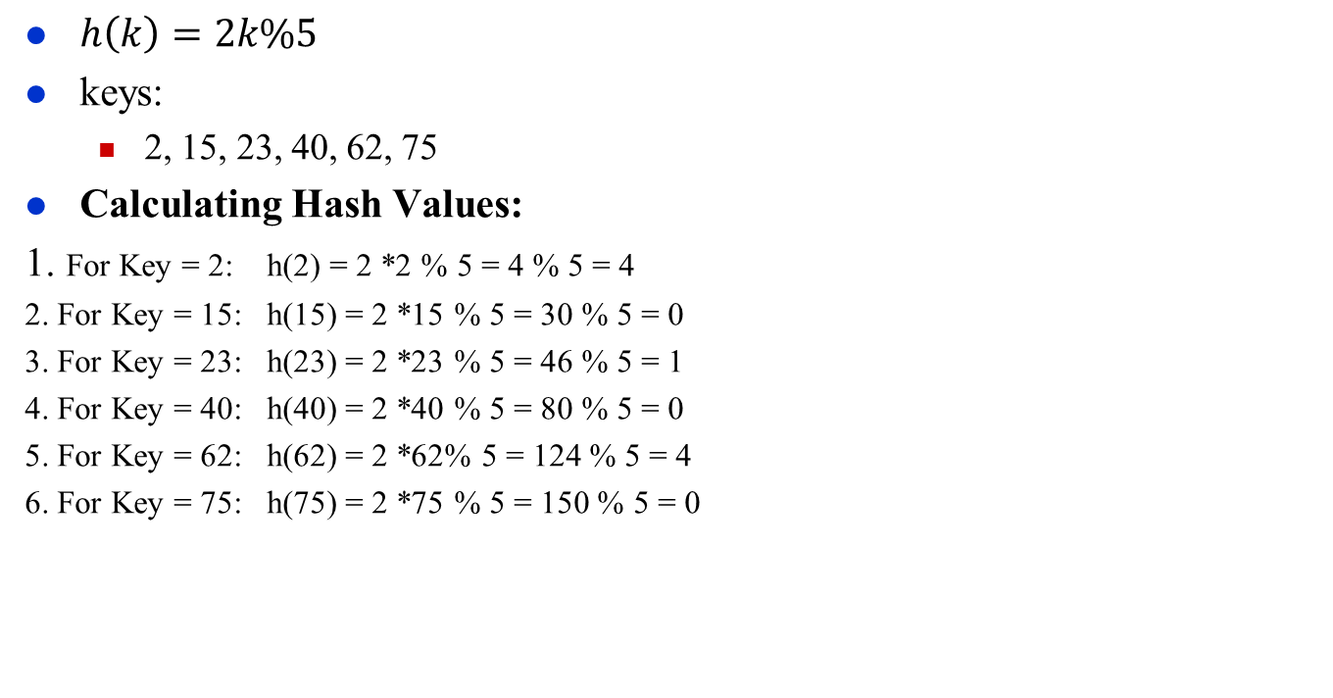
Chaining Example
$h\left(k\right)=2k\%5$
keys:
  2, 15, 23, 40, 62, 75
Calculating Hash Values:
1. For Key = 2: h(2) = 2 *2 % 5 = 4 % 5 = 4
2. For Key = 15: h(15) = 2 *15 % 5 = 30 % 5 = 0
3. For Key = 23: h(23) = 2 *23 % 5 = 46 % 5 = 1
4. For Key = 40: h(40) = 2 *40 % 5 = 80 % 5 = 0
5. For Key = 62: h(62) = 2 *62% 5 = 124 % 5 = 4
6. For Key = 75: h(75) = 2 *75 % 5 = 150 % 5 = 0

Slide 19

Chaining Example
$h\left(k\right)=2k\%5$
keys:
  20, 15, 40, 50, 75

Slide 20
Analysis of Chaining
Assume simple uniform hashing: each key in table is equally likely to be hashed to any slot
Given n keys and m slots in the table: the
load factor α = n/m = average # keys per slot
What will be the average cost of an unsuccessful search for a key?

Slide 21
Analysis of Chaining
Assume simple uniform hashing: each key in table is equally likely to be hashed to any slot
Given n keys and m slots in the table, the
load factor α = n/m = average # keys per slot
What will be the average cost of an unsuccessful search for a key? A: O(1+α)

Slide 22
Analysis of Chaining
Assume simple uniform hashing: each key in table is equally likely to be hashed to any slot
Given n keys and m slots in the table, the
load factor α = n/m = average # keys per slot
What will be the average cost of an unsuccessful search for a key? A: O(1+α)
What will be the average cost of a successful search?

Slide 23
Analysis of Chaining
Assume simple uniform hashing: each key in table is equally likely to be hashed to any slot
Given n keys and m slots in the table, the
load factor α = n/m = average # keys per slot
What will be the average cost of an unsuccessful search for a key? A: O(1+α)
What will be the average cost of a successful search? A: O(1 + α/2) = O(1 + α)

Slide 24
Analysis of Chaining
Draw the 11-item hash table that results from using
the hash function h(k) = (2k + 5) mod 11, to hash
the keys 12, 44, 13, 88, 23, 94, 11, 39, 20, 16, and 5,
assuming collisions are handled by chaining.

Slide 25
Open Addressing
Basic idea:
  To insert: if slot is full, try another slot, …, until an open slot is found (probing)
  To search, follow same sequence of probes as would be used when inserting the element
    If reach element with correct key, return it
    If reach a NULL pointer, element is not in table
Good for fixed sets (adding but no deletion)
  Example: spell checking
Table needn’t be much bigger than n

Slide 26
Probe Sequence
Sequence of slots examined during a key search constitutes a probe sequence.
Probe sequence must be a permutation of the slot numbers.
  We examine every slot in the table, if we have to.
  We don’t examine any slot more than once.
The hash function is extended to:
  h : U × {0, 1, …, m – 1} → {0, 1, …, m – 1}
  probe number slot number
⟨h(k, 0), h(k, 1),…,h(k, m – 1)⟩ should be a permutation of ⟨0, 1,…, m – 1 ⟩.

Slide 27
Computing Probe Sequences
The ideal situation is uniform hashing:
  Generalization of simple uniform hashing.
  Each key is equally likely to have any of the m! permutations of ⟨0, 1,…, m – 1⟩ as its probe sequence.
It is hard to implement true uniform hashing.
  Approximate with techniques that at least guarantee that the probe sequence is a permutation of ⟨0, 1,…, m – 1⟩.
Some techniques:
  Use auxiliary hash functions.
    Linear Probing.
    Quadratic Probing.
    Double Hashing.
  Can’t produce all m! probe sequences.

Slide 28
Linear Probing
h(k, i) = (h′(k) + i) mod m.
The initial probe determines the entire probe sequence.
  T[h′(k)], T[h′(k)+1], …, T[m–1], T[0], T[1], …, T[h′(k)–1]
  Hence, only m distinct probe sequences are possible.
Suffers from primary clustering:
  Long runs of occupied sequences build up.
  Long runs tend to get longer, since an empty slot preceded by i full slots gets filled next with probability (i+1)/m.
  Hence, average search and insertion times increase.
key
Probe number
Auxiliary hash function

Slide 29
Ex: Linear Probing
Example:
  h'(k) = k mod 13
  h(k, i) = (h'(k) + i) mod 13
  Insert keys 18, 41, 22, 44, 59, 32, 31, 73, in this order
0
1
2
3
4
5
6
7
8
9
10
11
12
41
18
44
59
32
22
31
73
0
1
2
3
4
5
6
7
8
9
10
11
12

Slide 30
Operation Insert
Act as though we were searching, and insert at the first NIL slot found.
Hash-Insert(T, k)
1. i ← 0
2. repeat j ← h(k, i)
3. if T[j] = NIL
4. then T[j] ← k
5. return j
6. else i ← i + 1
7. until i = m
8. error “hash table overflow”

Slide 31
Pseudo-code for Search
Hash-Search (T, k)
1. i ← 0
2. repeat j ← h(k, i)
3. if T[j] = k
4. then return j
5. i ← i + 1
6. until T[j] = NIL or i = m
7. return NIL

Slide 32

Example:
  h'(k) = k mod 13
  h(k, i) = (h'(k) + i) mod 13
  Some elements are already in the table
  Insert keys 17,30,43, in this order;
  search 27, 30, 26, 14
  delete 30; search 43;
0 | 1 | 2 | 3 | 4 | 5 | 6 | 7 | 8 | 9 | 10 | 11 | 12
 | 27 |  |  |  | 70

Slide 33
Deletion
Cannot just turn the slot containing the key we want to delete to contain NIL. Why?
Use a special value DELETED instead of NIL when marking a slot as empty during deletion.
  Search should treat DELETED as though the slot holds a key that does not match the one being searched for.
  Insert should treat DELETED as though the slot were empty, so that it can be reused.
Disadvantage: Search time is no longer dependent on α.
  Hence, chaining is more common when keys have to be deleted.
Notes:
Deletion from an open-address hash table is difficult. When we delete a key from slot i, we cannot simply mark that slot as empty by storing NIL in it. Doing so might make it impossible to retrieve any key k during whose insertion we had probed slot i and found it occupied.

Slide 34
Quadratic Probing
h(k, i) = (h′(k) + c₁i + c₂i²) mod m c₁≠ c₂
The initial probe position is T[h′(k)], later probe positions are offset by amounts that depend on a quadratic function of the probe number i.
Must constrain c₁, c₂, and m to ensure that we get a full permutation of ⟨0, 1,…, m – 1⟩.
Can suffer from secondary clustering:
  If two keys have the same initial probe position, then their probe sequences are the same.
key
Probe number
Auxiliary hash function

Slide 35
Primary vs Secondary Clustering
Primary clustering happens when multiple keys hash to the same location.
Secondary clustering happens when keys hash to different locations, but the collision-resolution has resulted in new collisions.

Slide 36
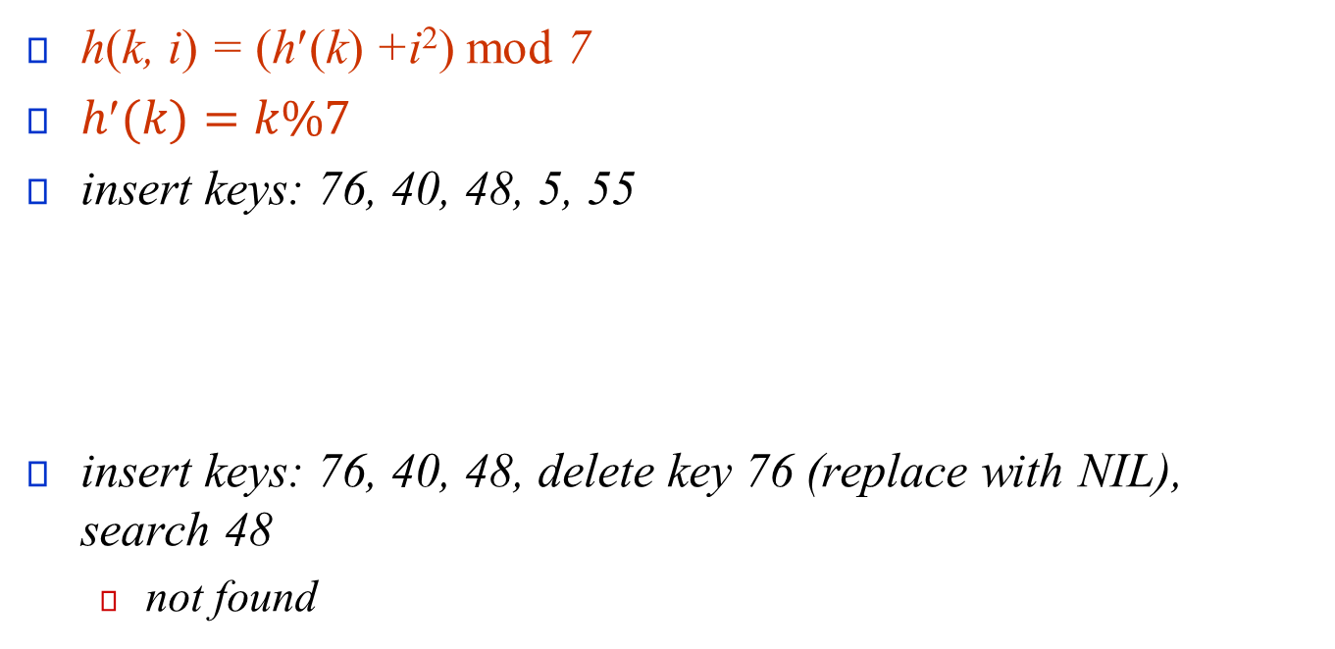
Quadratic Probing
h(k, i) = (h′(k) +i²) mod 7
$h(k)=k\%7$
insert keys: 76, 40, 48, 5, 55
insert keys: 76, 40, 48, delete key 76 (replace with NIL), search 48
  not found
0 | 1 | 2 | 3 | 4 | 5 | 6
48 |  | 5 | 55 |  | 40 | 76
0 | 1 | 2 | 3 | 4 | 5 | 6
48 |  |  |  |  | 40 | 76NIL

Slide 37
Double Hashing
h(k,i) = (h₁(k) + i h₂(k)) mod m
Two auxiliary hash functions.
  h₁ gives the initial probe.
  h₂ gives the remaining probes to ensure that subsequent probes do not follow a fixed pattern, helping to reduce clustering
For double hashing to work effectively, h₁(k) and h₂(k) must be relatively prime to the size of the hash table m. This ensures that the probe sequence covers the entire hash table without repetition, meaning every slot in the table is eventually probed.
key
Probe number
Auxiliary hash functions

Slide 38
Why Relatively Prime in Double Hashing?
In double hashing, having h₂(k) and the table size m be relatively prime ensures that the entire table can be probed. This prevents probing from revisiting the same set of locations (cycles), which would happen if h₂(k) shared a factor with m.

Slide 39
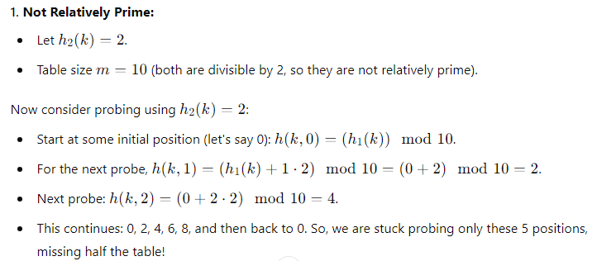
Why Relatively Prime in Double Hashing?
Let's assume the hash table size m is 10. Here are two cases:

Slide 40
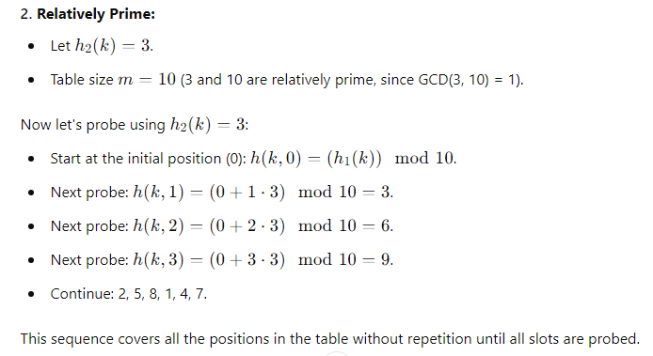
Why Relatively Prime in Double Hashing?
Let's assume the hash table size m is 10. Here are two cases:

Slide 41
Double Hashing
h(k,i) = (h₁(k) + i h₂(k)) mod m
Must have h₂(k) relatively prime to m, so that the probe sequence is a full permutation of ⟨0, 1,…, m – 1⟩.
  Choose m to be a power of 2 and have h₂(k) always return an odd number. Or,
  Let m be prime, and have 1 < h₂(k) < m.
key
Probe number
Auxiliary hash functions

Slide 42
Double Hashing
h(k,i) = (h₁(k) + i h₂(k)) mod m
Θ(m²) different probe sequences.
  Each sequence is defined by a different combination of h₁(k) and h₂(k), meaning that for each key, the collision resolution follows a distinct pattern
  Double hashing closely approximates the behavior of ideal uniform hashing, where each key would hash uniformly over all slots. This is because the combination of h₁​ and h₂​ gives a unique probing sequence for each key, minimizing clustering and increasing efficiency.
key
Probe number
Auxiliary hash functions

Slide 43
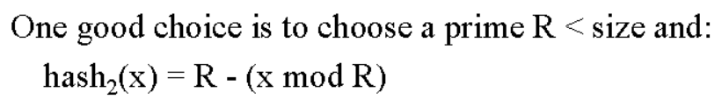
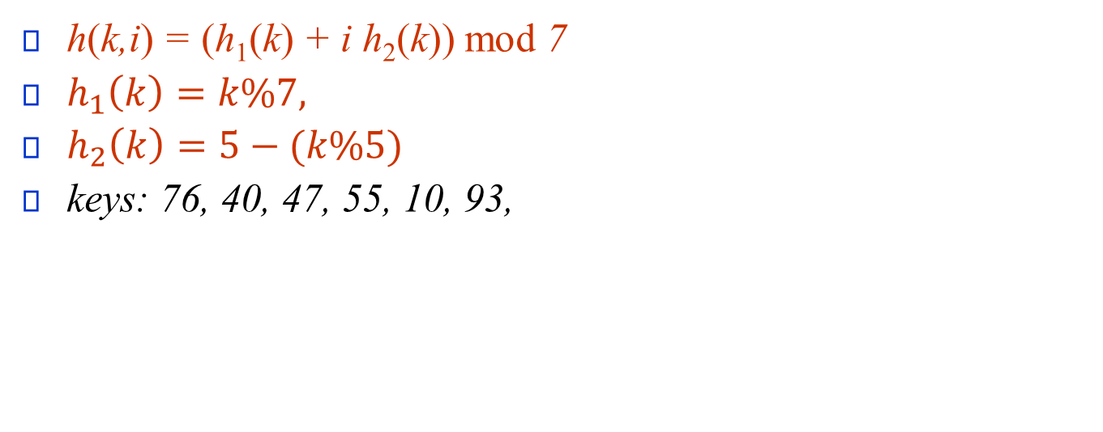
Double Hashing
h(k,i) = (h₁(k) + i h₂(k)) mod 7
$h_{1}\left(k\right)=k\%7,$
$h_{2}\left(k\right)=5−(k\%5)$
keys: 76, 40, 47, 55, 10, 93,
0 | 1 | 2 | 3 | 4 | 5 | 6

Slide 44
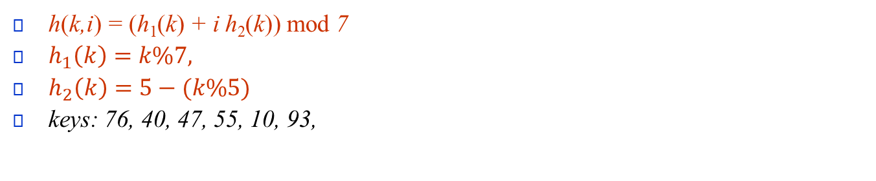
Double Hashing
h(k,i) = (h₁(k) + i h₂(k)) mod 7
$h_{1}\left(k\right)=k\%7,$
$h_{2}\left(k\right)=5−(k\%5)$
keys: 76, 40, 47, 55, 10, 93,
0 | 1 | 2 | 3 | 4 | 5 | 6

Slide 45

Double Hashing
Consider an open addressing hash table as shown below with the following items added beforehand.
This function uses the following hash function to manage collisions:
ℎ(𝑘, 𝑖) = (ℎ₁(𝑘) + 𝑖 ℎ₂(𝑘)) 𝑚𝑜𝑑 10
Where, ℎ₁(𝑘) = (3𝑘 + 5) 𝑚𝑜𝑑 10 and
ℎ₂(𝑘) =(2𝑘 + 3) 𝑚𝑜𝑑 10
Now, show calculations for the following operations and redraw the given hash table after the insertions.
  i) Insert 72
  ii) Insert 64
  iii) Search 44

Slide 46
Chaining Vs Open Addressing
Chaining
Open addressing
Advantage
  If number of elements grow unpredictably, chaining allows flexible handling of collision
  Chaining works well even when the load factor (number of elements / table size) exceeds 1.
  Handles deletion properly
Disadvantage
  Storing pointers to next element in the chain requires additional memory usage
Advantage
  Good for fixed or predictable number of elements.
  Avoids extra memory requirement for additional information
Disadvantage
  Deletion is complex
  When the table becomes too full, probing sequences grow longer, significantly slowing down insertions and lookups.

Slide 47
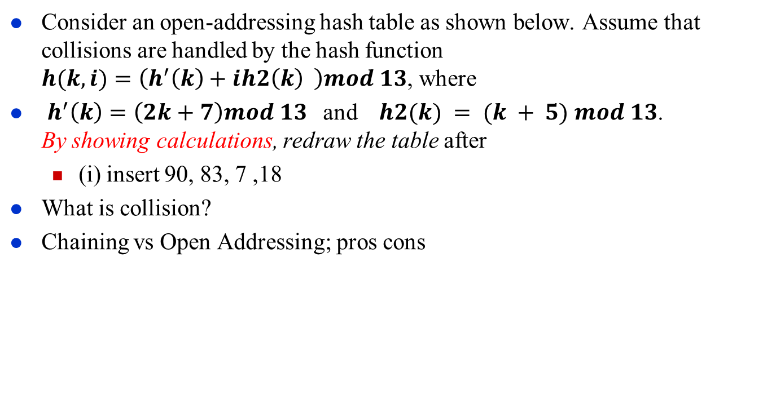
Exercise
Consider an open-addressing hash table as shown below. Assume that collisions are handled by the hash function
$h(k, i)=\left(h^{′}\left(k\right)+ih2\left(k\right) \right)mod 13$, where
$h^{′}\left(k\right)=\left(2k+7\right)mod 13$and $h2(k) = (k + 5) mod 13$.
By showing calculations, redraw the table after
  (i) insert 90, 83, 7 ,18
What is collision?
Chaining vs Open Addressing; pros cons

